Slide 1
INTERNATIONALIZATION OF PORTUGUESE SME TO JAPAN: A FOCUS ON EXPORT BARRIERS
Roberto Martins
Supervision:
Ana Paula Africano de Sousa e Silva
Paulo João Figueiredo Cabral Teles

Slide 2
Table of contents
Introduction
Literature Review
3. Methodology
4. Findings
5. Conclusion

Slide 3
Introduction
Capitalize on historical and cultural heritage abroad
The need to diversify to different markets
Recent diplomatic developments between Portugal and Japan
Notes:
Resolução do Conselho de Ministros n. º 3/2010: “assume a internacionalização da economia portuguesa como estratégia fundamental para uma recuperação económica sustentada”
Questão da investigação: principais barreiras à exportação para as PME portuguesa;
Motivação: novos mercados, reformas japonesas, EPA;
Relevância: EPA

Slide 4
Portugal-Japan Trade Overview
1974-2020 Trade Balance
Source: INE (2020)
Official visits
New regime
CEE/UE
Bailout
EPA
€298,594,111
Notes:
2020: IMP = €292,415,731

Slide 5
Introduction
The need to diversify to different markets
Capitalize on historical and cultural heritage abroad
Recent diplomatic developments between Portugal and Japan
Few research in export barriers to Japan from Portugal
Japan’s eagerness for reforms
EU-Japan Economic Partnership Agreement (EPA)
Notes:
Resolução do Conselho de Ministros n. º 3/2010: “assume a internacionalização da economia portuguesa como estratégia fundamental para uma recuperação económica sustentada”
Questão da investigação: principais barreiras à exportação para as PME portuguesa;
Motivação: novos mercados, reformas japonesas, EPA;
Relevância: EPA

Slide 6
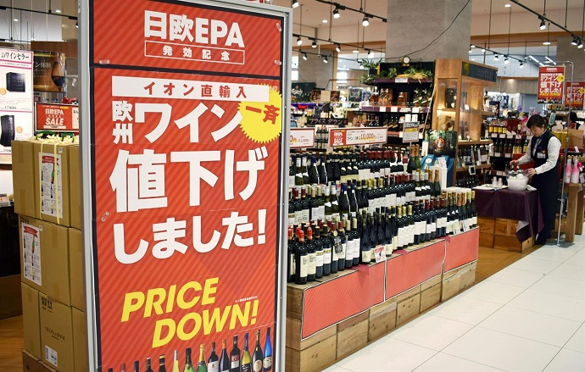
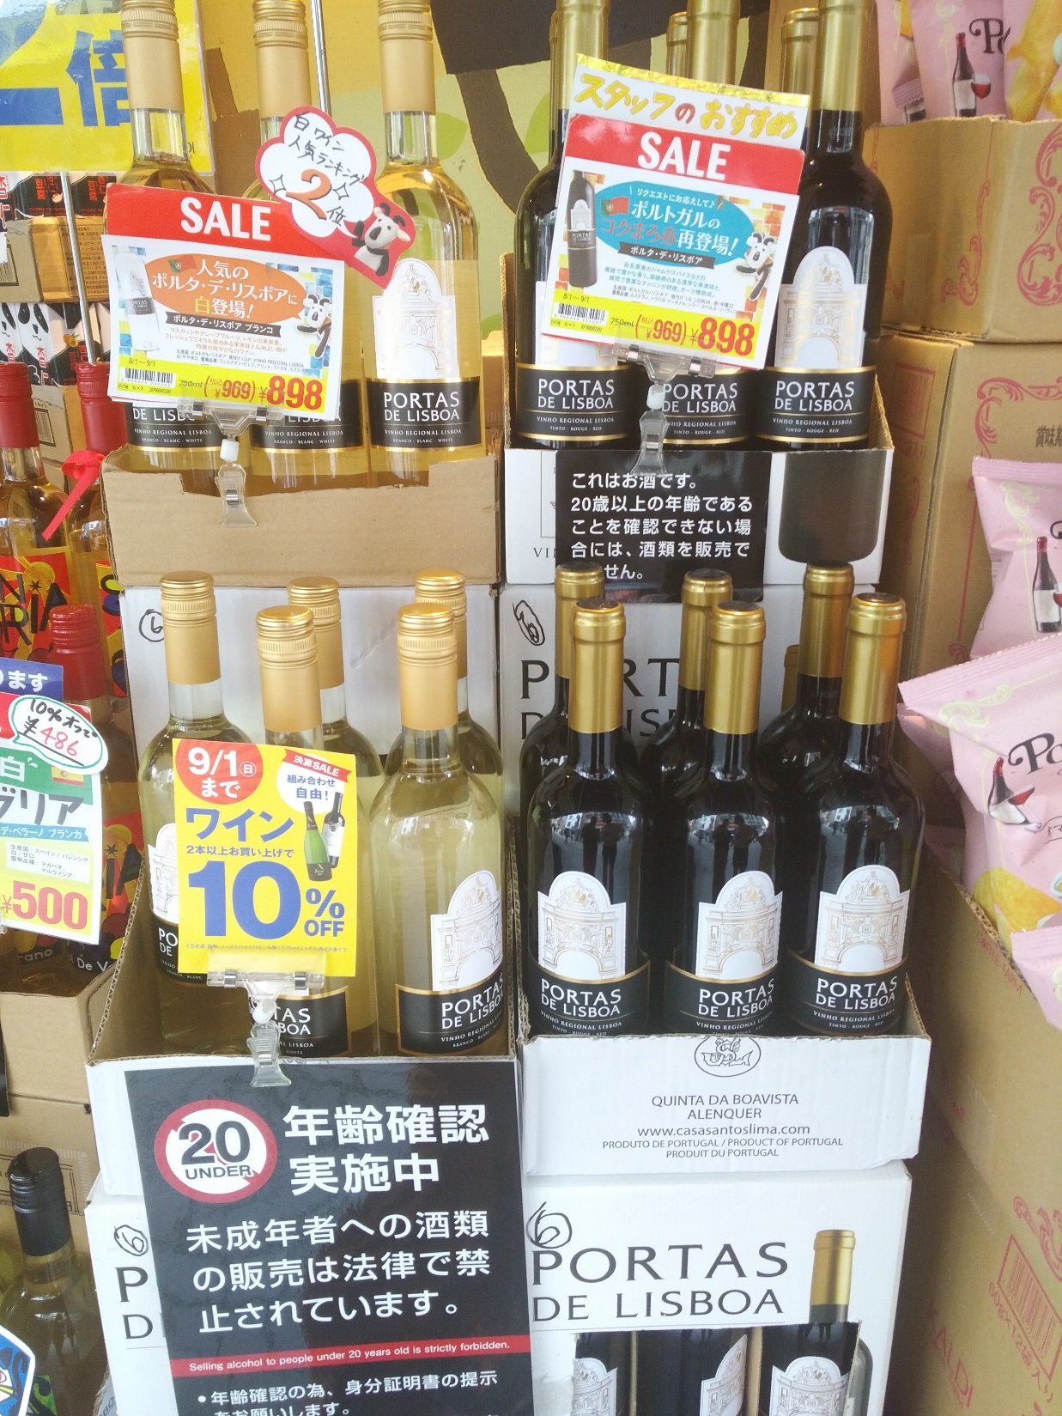
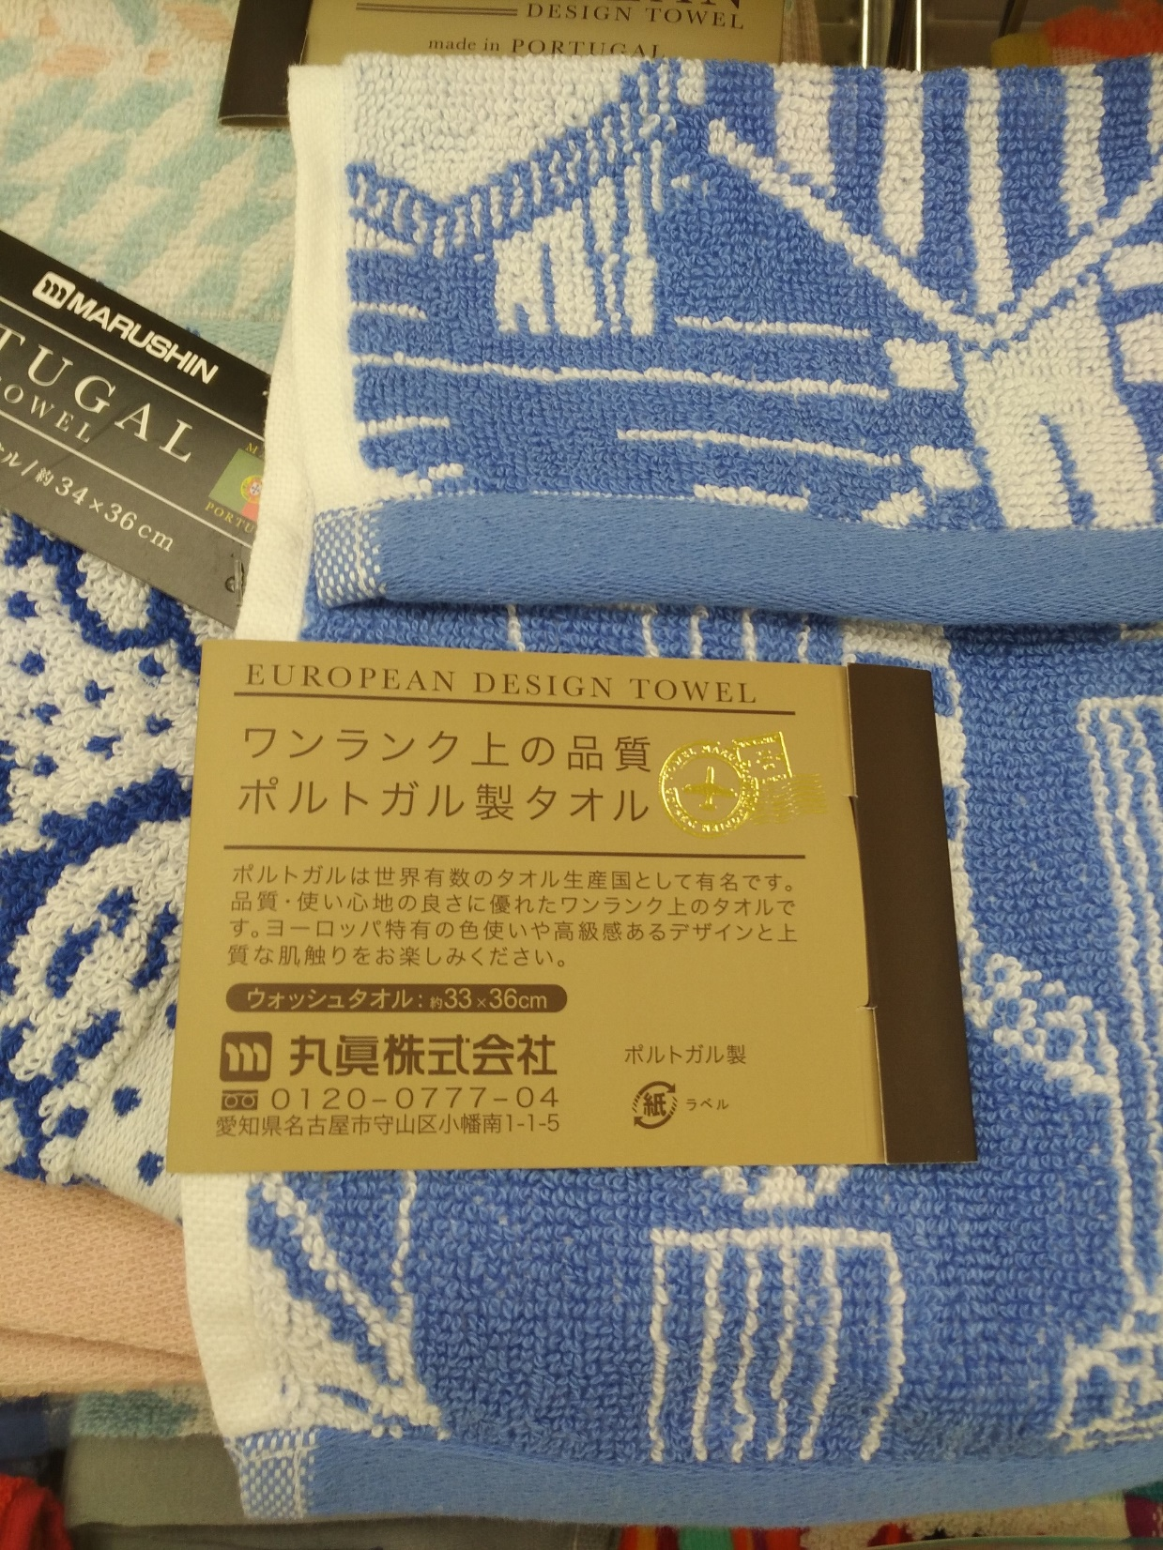
Portugal-Japan Trade Overview
15 year period
1 February 2019
91-97% reduction
Notes:
Este aumento poderá ter sido influenciado pelo Acordo Económico. Eu cheguei a falar com a AICEP Tóquio e, no entanto, não me confirmaram.
O APE entrou finalmente em vigor em 2019, entre o Japão e a União Europeia. E é um acordo centrado principalmente na redução de tarifas de vários produtos agrícolas europeus para o Japão.

Slide 7
identify which export barriers are most relevant for Portuguese exporters (SMEs) to Japan.
Goal:

Slide 8
Literature Review
Export
Grouping export barriers
Studies on Japan

Slide 9
Risk
Resources
Market knowledge
Choice of entry modes
Non-equity modes
Equity (FDI) modes
Direct exports
Contractual
agreements
Joint
ventures
Wholly owned
subsidiaries
Indirect exports
Licensing/franchising
Minority JVs
Greenfields
Others
Turnkey projects
50–50 JVs
Acquisitions
R&D contracts
Majority JVs
Others
Co-marketing
Peng, M. (2018)

Slide 10
Export barriers
Financial
Culture
Language
HR
Management
Quotas
Competition
Regulations
Capacity
Packaging
NTB
Tariffs
Product Dev.

Slide 11
Export barriers
Financial
Culture
Language
HR
Management
Quotas
Competition
Regulations
Capacity
Packaging
NTB
Tariffs
Product Dev.

Slide 12
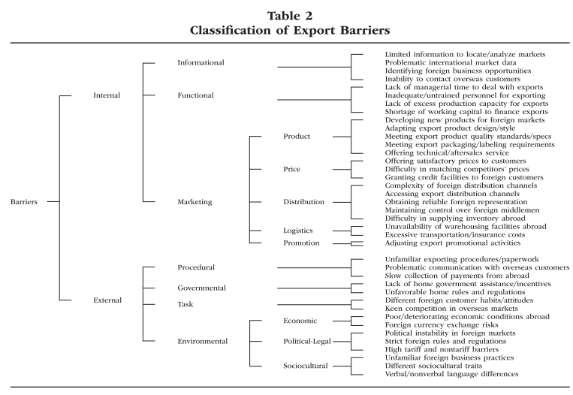
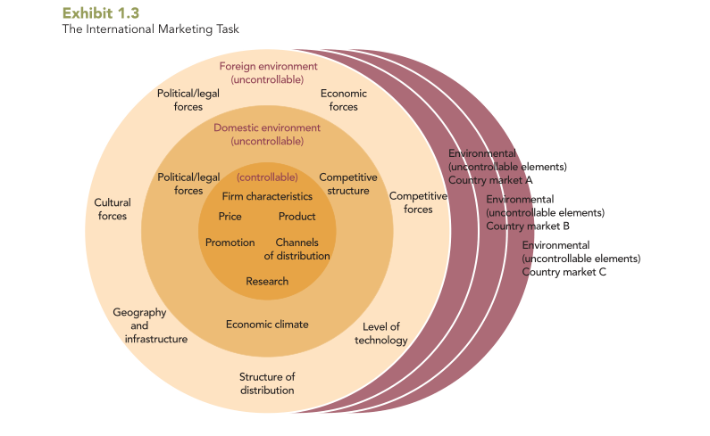
Leonidou, L. (2004)
Cateora et al. (2011)
Controllable Elements
Uncontrollable Elements
Domestic Environment
Foreign Environment
Informational Barriers
Governmental Barriers
Distribution
Procedural Barriers
Functional Barriers
Political and Legal
Forces
Culture
Competition
Task Barriers
Firm characteristics
Economic climate
Economy
Political
Legal
Geography
Level of technology
Environmental Barriers
Marketing Barriers
Competition
Marketing Mix
Adapted from Leonidas (2004), and Cateora et al. (2011)
Notes:
No que toca a autores sobre barreiras à exportação, um dos autores mais citados na literatura é o trabalho de Leonidou de 2004.

Slide 13
Notes:
Este estudo acaba por ser semelhante ao estudo desenvolvido pela OCDE, desenvolvido em 2008, que utilizou a mesma categorização das barreiras à exportação de Leonidou, e acrescentou algumas. Este estudo também recorreu a questionários, onde foi solicitado o preenchimento de através de uma escala de likert. Este estudo, no entanto, procedeu da mesma forma junto a agentes institucionais, para depois comparar quais as barreiras são percepcionais mais importantes tanto pelas PME como pelos agentes institucionais.

Slide 14
Studies on Japan
Author(s) | Barriers Categorization | Conclusions
Samiee & Mayo (1990) | (1) Visible and (2) Invisible barriers | Social and Cultural characteristics have an impact on Japan's barriers.
Czinkota & Kotabe (1999, 2000) | (1) Business Environment, (2) Regulations, (3) Costs of Doing Business, and (4) Consumer Behavior | Regulatory and Business environment are becoming “foreign-friendly”, but Consumer Behavior is still a major barrier.
Maguire (2001) | (1) NTB, (2) Business Environment, and (3) Consumer Behavior | NTB are important barriers.
Ojala & Tyrväinen (2007) | (1) Organization-Related Barriers, (2) Sales Process–Related Barriers, and (3) Target Industry Segment–Related Barriers | Convincing headquarters of the Japanese market-specific demands is a challenge.

Slide 15
Studies on Japan
Author(s) | Study goal | Author(s) | Study goal
Simon & Palder (1987) | Successful entry strategies. | Gehrt et al. (2005) | Assessment of informal trade barriers among Japanese intermediaries.
Buckley et al. (1987) | European FDI in Japan as a market entry strategy. | Uzama (2009) | Market Entry Model Selection.
Douglas & Craig (1990) | Successful entry strategies. | Sunesen et al. (2010) | Report on perceived Trade Barriers between Japan and the EU.
Williamson & Yamawaki (1991) | Assessment of the distribution system. | Padron et al., (2011) | Assessment of FDI in Japan by EU firms.
Min (1996) | Assessment of the distribution system. | Haghirian (2011) | Assessment of the Japanese consumer behaviour.
Pirog et al. (1997) | Socio-cultural influences on distribution. | Bebenroth et al. (2014) | Institutional barriers perceptions.
Wong et al. (1999) | Assessment of foreign rice acceptance in Japan. | Mazur (2016) | Main barriers for European enterprises.
Yamawaki (2004) | Exit patterns of manufacturing foreign firms in Japan. | Felbermayr et al. (2017) | Impacts of the EU-Japan EPA.

Slide 16
Listing barriers to Leonidou’s model
Controllable |  | Informational | Samiee & Mayo (1990), Ojala & Tyrväinen (2007)
 |  | Functional | Simon & Palder (1987), Buckley et al. (1987), Czinkota & Kotabe (1999, 2000), Maguire (2001), Ojala & Tyrväinen (2007)
 |  | Marketing | Simon & Palder (1987), Buckley et al. (1987), Douglas & Craig (1990), Wong et al. (1999), Maguire (2001), Padron et al. (2011), Haghirian (2011)
Uncontrollable | Domestic | Governmental
 |  | Economic Climate
 |  | Competition
 | Foreign | Procedural | Sunesen et al. (2010)
 |  | Task | Simon & Palder (1987), Buckley et al. (1987), Samiee & Mayo (1990), Douglas & Craig (1990), Min (1996), Wong et al. (1999), Czinkota & Kotabe (1999, 2000), Ojala & Tyrväinen (2007), Sunesen et al. (2010), Haghirian (2011), Mazur (2016)
 |  | Environmental | Simon & Palder (1987), Buckley et al. (1987), Samiee & Mayo (1990), Williamson & Yamawaki (1991), Min (1996), Pirog et al. (1997), Wong et al. (1999), Czinkota & Kotabe (1999, 2000), Maguire (2001), Yamawaki (2004), Gehrt et al. (2005), Ojala & Tyrväinen (2007), Uzama (2009), Sunesen et al. (2010), Padron et al. (2011), Bebenroth et al. (2014), Mazur (2016), Felbermayr et al. (2017)

Slide 17
Common aspects
Controllable elements:
Gather information
High product quality expectation
Product adaptation = higher costs
After-sale service
Management commitment
Uncontrollable elements:
Distribution channel
NTB
Keiretsu
Regulatory environment
Language
Technical and adminstrative
barriers

Slide 18
Research Methodology
Research goal
Research strategy
Questionnaire
Interview
Sample

Slide 19
Research goal
Identify and describe barriers that Portuguese small and medium enterprises (SMEs) exporting to Japan encounter.
Definition | Size | Volume
Micro | < 10 | < 10 million
Small | < 50 | < 2 million
Medium | < 250 | < 50 million
Notes:
article 2 of the Annex of the Decreto-Lei n. º 373/2007 de 6 de Novembro

Slide 20
Research strategy
Interviews:
AICEP, ViniPortugal, and GOD Works (marketing firm)
Questionnaires:
Part 1
Company details........................................................................................8
Part 2
International experience...........................................................................6
Part 3
Internationalization to Japan...................................................................9
Part 4
Export barriers assessment...................................................................31
Part 5
External support........................................................................................2
Notes:
56 perguntas.

Slide 21
Controllable elements
Uncontrollable elements
Informational barriers:
01. Limited information to locate/analyse the Japanese market
02. Identify business opportunities in Japan
Functional barriers:
03. Lack of managerial time to deal with the Japanese market
04. Insufficient quantity of and/or untrained personnel
05. Lack of excess production capacity for exports to Japan
06. Shortage of working capital to finance exports to Japan
Marketing barriers:
07. Developing new products for the Japanese market
08. Meeting the export product quality, standards, specifications
09. Meeting export packaging and labelling requirements
10. Offering technical/after-sales service in Japan
11. Offering products with a competitive price-quality relation
12. Complexity of the Japanese distribution system
13. Difficulty in establishing a partnership/representation
14. Difficulty in maintaining control over representation/image
15. Excessive transportation/insurance costs
16. Adjusting export promotional activities to Japan
Governmental barriers (domestic):
17. Lack of home government assistance/incentives for export activities
Procedural barriers:
18. Complex export procedures for Japan
19. Difficulties in directly communicating with Japanese customers (time difference and distance)
20. Difficulty in collection of payment from Japan
Task barriers:
21. Understanding the different customer habits and attitudes
22. Low awareness by Japanese consumers of the Portuguese offer
23. Keen competition in the Japanese market
Environmental barriers:
24. Political and economic conditions in Japan
25. Japanese business culture and practices
26. Differences in verbal (language) and non-verbal (culture) communication
27. Specific Japanese market norms and regulations
28. High cost of customs

Slide 22
Questionnaires
Exploratory Analysis
Factor Analysis

Slide 23
Questionnaires
IMPORTANCE LEVELS:
• 0% - 30% = “Very Low”;
• 30% - 40% = “Low”;
• 40% - 50% = “Moderately low”;
• 50% - 60% = “Moderate” important;
• 60% - 70% = “Moderately high”;
• 70% - 80% = “High”;
• 80% - 100% = “Very high”.

Slide 24
Sample
AICEP
(2019)
1072 contacts
INE
(2020)

Slide 25
Weekend
Weekend
Weekend
Weekend
970 e-mails sent
Phone calls
Phone calls
Phone calls
1040 e-mails sent
50 e-mails sent
1095 e-mails sent
Notes:
Batch e-mails: 27 April, 6 May, 24 May,
Phones calls from 10 – 21 May: 664 phone calls (includes answered calls);
Total of 3524 emails were sent
48 companies informed not to have ever exported to Japan

Slide 26
Completed: 75
Invalid: 3
Big companies: 12
60

Slide 27
Findings and Discussion
Questionnaire results
Exploratory analysis
Factor analysis

Slide 28
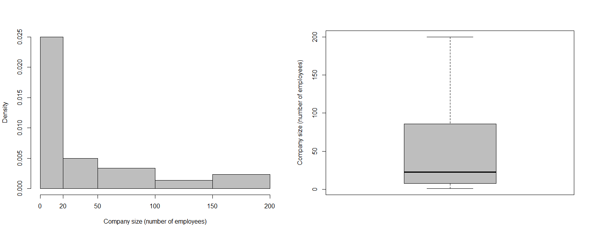
Part 1
Foundation year:
Youngest = 2018; Oldest = 1922;
No year stands out;
CAE:
Wholesale trade (incl. agents), exc. of motor vehicles and motorcycles (CAE 46);
Beverages industry (CAE 11);
Food products industry (CAE 10);
Manufacture of textiles (CAE 13);
Manufacture of leather and leather products (CAE 15);
Company size:
Mean size = 54;
Smallest = 1 (n = 2);
Largest = 200 (n = 2);
Presence of foreign capital:
90% = no foreign capital.
~23
Notes:
46: Comércio por grosso (inclui agentes), excepto de veículos automóveis e motociclos
11: Indústria das bebidas
10: Indústrias alimentares
13: Fabricação de têxteis
15: Indústria do couro e dos produtos do couro

Slide 29
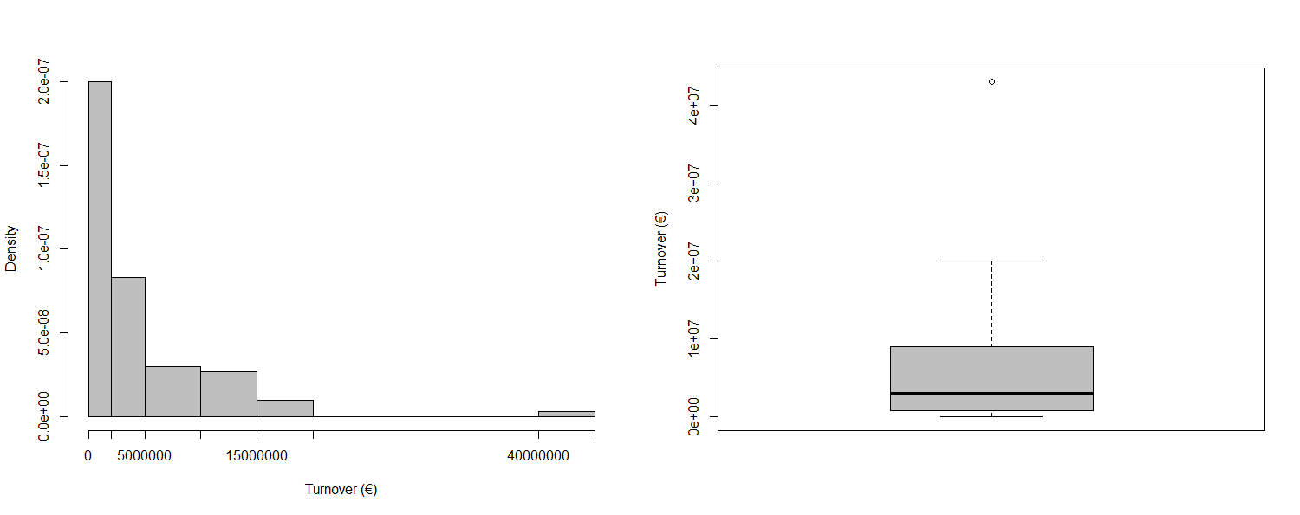
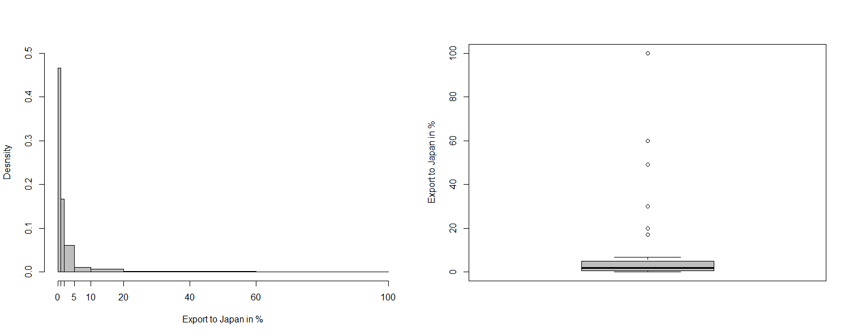
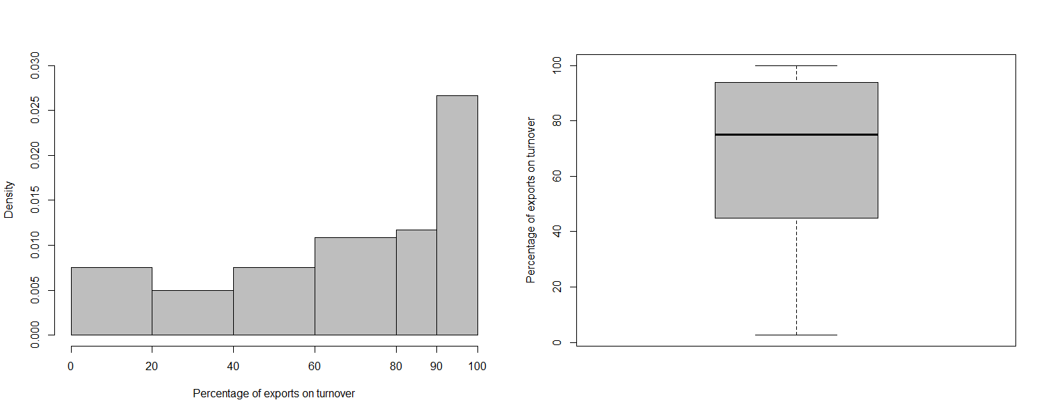
Part 1
Export to Japan % (3-year):
Mean = 6.8%;
Smallest = 0% (n = 1);
Largest = 100% (n = 1);
>50% (n = 2).
Part 1
Turnover (3-year average):
Mean = €5,694,147;
Smallest = €10,000;
Largest = €43,000,000;
Export % (3-year):
Mean = 66%;
Smallest = 2.6%;
Largest = 100% (n =3);
Export to Japan % (3-year):
Mean = 6.8%;
Smallest = 0% (n = 1);
Largest = 100% (n = 1);
>50% (n = 2).
Notes:
Spread is very high, as shown by the coefficient of variation (127%), as a consequence of large differences among companies.

Slide 30
Part 2
Internationalization year:
Youngest = 2019; Oldest = 1932;
1986 (n = 6);
Internationalization method:
Export = 57;
FDI = 1;
Other (n = 2):
Online sale;
Sales stand on a European Championship;
First country of internationalization:
Most common = Spain;
Missing values = 3;
Foreign countries count (currently):
Mean = 22.7;
Smallest = 0 (n = 1);
Largest = 65 (n = 2).

Slide 31
Part 2
Export department/manager:
Yes = 58.3% (n = 35);
HR competencies:
M
 | n | %
No | 29 | 46.8%
Japanese person | 3 | 4.8%
Worked in Japan | 1 | 1.6%
University degree related to Japan | 1 | 1.6%
Speaks Japanese | 1 | 1.6%
Other | 27 | 43.5%

Slide 32
Part 3
Internationalization year:
Youngest = 2020 (n = 4); Oldest = 1975 (n = 1);
Missing values = 2;
Internationalization method:
Export = 91.7% (n = 55);
Contratual agreements = 3.3% (n = 2);
Other = 3.3% (n = 2);
“Sales via Japanese athletes” = 1;
“International exhibition” = 1;
Missing value = 1;
Motives:
Received order = 22% (n = 33);
Purchasing power = 18.7% (n = 28);
Market size = 14% (n = 21);
Distribution method:
Most common = Local distributor (37.7%).
M
M

Slide 33
Part 3
Export regularity:
Regularly = 60% (n = 36);
Effort perception:
Very demanding + Demanding= 61.7%;
EU-Japan EPA assessment:
Big support = 15% (n = 9);
Export to neighboring countries:
P. R. China (incl. HK, Macao) = 47.4%;
South Korea & Taiwan = 33.5%;
No other Asian country = 12.4%;
Similar markets to Japan:
None = 37.5%;
South Korea = 29%;
Taiwan = 12.5%;
Does not know = 2 respondents.
M
M

Slide 34
Part 4
EXAMPLE
01. Limited information to locate/analyse the Japanese market
1
2
3
4
5
Not/Little Important |  | Somewhat Important |  | Important |  | Quite Important |  | Very Important
n | % | n | % | n | % | n | % | n | %
9 | 15 | 11 | 18.3 | 17 | 28.3 | 15 | 25 | 8 | 13.3
• 0% - 30% = “Very Low”;
• 30% - 40% = “Low”;
• 40% - 50% = “Moderately low”;
• 50% - 60% = “Moderate”;
• 60% - 70% = “Moderately high”;
• 70% - 80% = “High”;
• 80% - 100% = “Very high”.
0.283 + 0.25 + 0.133 = 66.7%

Slide 35
Part 4
02. Identify business opportunities in Japan HIGH [71.7%]
17. Lack of home government assistance/incentives for export activities MODER. HIGH [68.3%]
22. Low awareness by Japanese consumers of the Portuguese offer MODER. HIGH [68.3%]
23. Keen competition in the Japanese market MODER. HIGH [68.3%]
01. Limited information to locate/analyse the Japanese market MODER. HIGH [66.7%]
15. Excessive transportation/insurance costs MODER. HIGH [66.7%]
16. Adjusting export promotional activities to Japan MODER. HIGH [66.7%]
13. Difficulty in establishing a partnership/representation in Japan MODER. HIGH [65.0%]
25. Japanese business culture and practices MODER. HIGH [65.0%]
21. Understanding the different customer habits and attitudes MODER. HIGH [63.3%]
28. High cost of customs M. HIGH / MOD. [60.0%]
03. Lack of managerial time to deal with the Japanese market MODERATE [58.3%]
11. Offering products with a competitive price-quality relation MODERATE [58.3%]
18. Complex export procedures for Japan MODERATE [58.3%]
26. Differences in verbal (language) and non-verbal (culture) com. MODERATE [58.3%]
04. Insufficient quantity of and/or untrained personnel MODERATE [53.3%]
19. Difficulties in directly communicating with Japanese customers MODERATE [53.3%]
07. Developing new products for the Japanese market MODERATE [51.7%]
08. Meeting the Japanese export product quality, standards, specificationsMODERATE [51.7%]
12. Complexity of the Japanese distribution system MODERATE [51.7%]
14. Difficulty in maintaining control over representation/image in Japan MODERATE [51.7%]
27. Specific Japanese market norms and regulations MOD. / MO. LOW [50.0%]
10. Offering technical/after-sales service in Japan MODER. LOW [48.3%]
09. Meeting export packaging and labelling requirements MODER. LOW [45.0%]
05. Lack of excess production capacity for exports to Japan MO. LOW / LOW [40.0%]
24. Political and economic conditions in Japan MO. LOW / LOW [40.0%]
06. Shortage of working capital to finance exports to Japan LOW [35.0%]
20. Difficulty in collection of payment from Japan VERY LOW [20.0%]
01. Limited information to locate/analyse the Japanese market
02. Identify business opportunities in Japan
03. Lack of managerial time to deal with the Japanese market
04. Insufficient quantity of and/or untrained personnel for working with the Japanese market
05. Lack of excess production capacity for exports to Japan
06. Shortage of working capital to finance exports to Japan
07. Developing new products for the Japanese market
08. Meeting the Japanese export product quality, standards, specifications
09. Meeting export packaging and labelling requirements
10. Offering technical/after-sales service in Japan
11. Offering products with a competitive price-quality relation
12. Complexity of the Japanese distribution system
13. Difficulty in establishing a partnership/representation in Japan
14. Difficulty in maintaining control over representation/image in Japan
15. Excessive transportation/insurance costs
16. Adjusting export promotional activities to Japan
17. Lack of home government assistance/incentives for export activities
18. Complex export procedures for Japan
19. Difficulties in directly communicating with Japanese customers (time difference and distance)
20. Difficulty in collection of payment from Japan
21. Understanding the different customer habits and attitudes of the Japanese
22. Low awareness by Japanese consumers of the Portuguese offer
23. Keen competition in the Japanese market
24. Political and economic conditions in Japan
25. Japanese business culture and practices
26. Differences in verbal (language) and non-verbal (culture) communication
27. Specific Japanese market norms and regulations
28. High cost of customs
INTERNAL BARRIERS
EXTERNAL BARRIERS

Slide 36
Part 5
Institutional support:
Half has access to external support;
Reasons:
M
 | n | %
Networking | 20 | 30.8%
Access to information | 18 | 27.7%
Participate in Business Missions | 13 | 20.0%
Other | 8 | 12.3%
Access to finance | 6 | 9.2%

Slide 37
Factor analysis
FACTOR
ANALYSIS
Part 1:
Company details;
Economic activity classification;
Company size;
Foreign capital;
Foreign capital %;
3-year average turnover;
% export;
% export to Japan;
Part 2:
Internationalization year;
Internationalization method;
First country of internationalization;
Number of foreign countries a company is present at the moment;
Export department;
HR-competencies;
Part 3:
Year of internationalization to Japan;
Internationalization method to Japan;
Motives;
Distribution method;
Export regularity to the Japanese market;
Effort perception;
EPA assessment;
Nearby countries export;
Nearby countries similarity;
Part 4:
Barriers (28 + 3 optional);
Part 5:
Institutional support (1 + 1 optional).

Slide 38
Market research capabilities
Barriers to information and business opportunities
1
Domestic government support
Product development requirements
Product development
2
Product adaptation
Local competition
Market and business culture challenges
3
Different culture and idiom
Awareness (bypasing ethnocentrism)
Barriers to distribution
Distribution adjustment
4
Competitive price
Comply with regulations
Geographic constraints
Advertisement, events
Transport
5
Communication
Customs
Qualified and dedicated human resources
Knowledge
Time
6
Offer technical/after-sales services
Constraints due to company’s low capacity
Financial resources
7
Production capacity
Foreign environment

Slide 39
IMPORTANCE LEVELS:
• 0% - 30% = “Very Low”;
• 30% - 40% = “Low”;
• 40% - 50% = “Moderately low”;
• 50% - 60% = “Moderate”;
• 60% - 70% = “Moderately high”;
• 70% - 80% = “High”;
• 80% - 100% = “Very high”.
Barriers to information and business opportunities
Barriers to information and business opportunities
1
69.7%
Product development requirements
Product development requirements
2
54.7%
Market and business culture challenges
Market and business culture challenges
3
68.9%
Barriers to distribution
Barriers to distribution
4
61.6%
Geographic constraints
Geographic constraints
5
65.2%
Qualified and dedicated human resources
Qualified and dedicated human resources
6
57.3%
Constraints due to company’s low capacity
Constraints due to company’s low capacity
7
40%

Slide 40
Conclusion

Slide 41
Conclusion
Diverse CAE
Small size
SME Exporter to Japan
New categorization
Export-oriented
Dimension 1 moder. high
Information & Opportunities
60% regularly export to Japan
Export barriers are perceived as moderately important
Dimension 2 moderately
Product Development
Dimension 3 moder. high
Japanese business practice
High: 1 barrier (no. 2)
Average 6.8
EPA:
~43% not aware
Moderately high: 10 barriers
Dimension 4 moder. high
Distribution
Moderate: 11 barriers
Dimension 5 moder. high
Distance
Lack of HR
Demanding
Moderately low: 4 barriers
Dimension 6 moderately
Human resources
Low: 1 barrier (no. 6)
Very low: 1 barrier (no. 20)
Dimension 7 low
Firm’s capacity

Slide 42
Conclusion
Opportunity: firms shouldn’t miss out on the EPA
Commitment: firms should aim for mature and stable markets
Learning curve: cooperation with external agents may help
Offer: betting on niche markets may bring more return
Distance: unnavoidable
Capacity: firms shouldn’t dismiss “invisible barriers”

Slide 43
Thank you. Obrigado. ありがとうございます。

Slide 44
ERRATUM
On page 17, where it reads “followed by 20 studies”, it should read “followed by 16 studies”;
On page 39, where it reads “[...] an explanation for each individual barrier is given in Annex F”, it should read “the importance levels for each barrier is given in Annex F”;
On page 45, table 18, regarding Dimension 3, should include barrier no. 26;
On page 47, where it reads “[...] barrier 5 is perceived as the least important barrier”, it should read “[...] one of the least important barriers.”
On page 52, where it reads “[...] all barriers on dimension 1, except 14, are moderately important and one is high (barrier 2);”, it should read “[...] are moderately high in importance and one is high [...].”
On page 52, where it reads “all barriers on dimension 3 are moderately important [...]”, it should read “all barriers on dimension 3 are moderately high in importance and one is moderate (barrier 26)”;
On page 52, where it reads “and 3 barriers (15, 16, and 28) on dimension 5 are moderately important” it should read “[...] are moderately high in importance.”

Slide 45
